Slide 1
Unit 2 For Live Session Assignment
Isabella Westlauer
1/26/2026
Notes:
Download into R Studio the PlayerBBall.csv dataset. This data set is every NBA basketball player from 1950 to present. It contains their height, weight, position and the year they played (among other data.) (Position: F-Forward, C-Centers, F-C and C-F – Forward /Centers, G – Guards, F-G – Forward/Guards) FYI: If you feel that these questions are open ended or at least a little vague, this is on purpose. Answer the question as you understand it and make any assumptions you need to make to answer the question and record those assumptions. (3-5 hours)

Slide 2
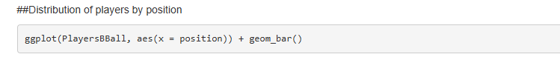
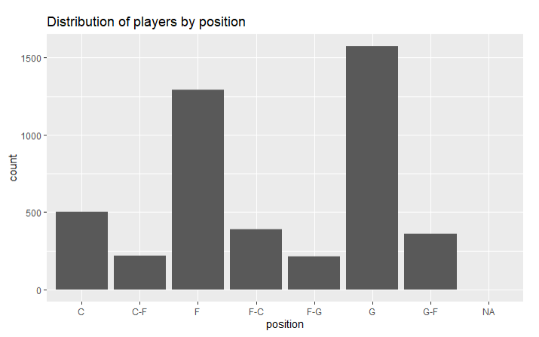
Notes:
Use the PlayerBBall.csv dataset to visually represent (summarize) the number of players in each position.

Slide 3
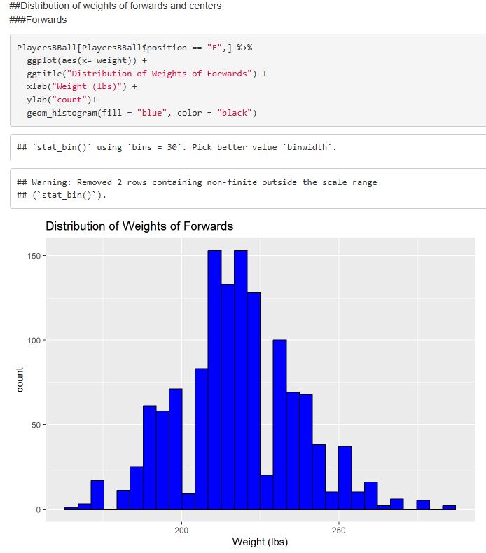
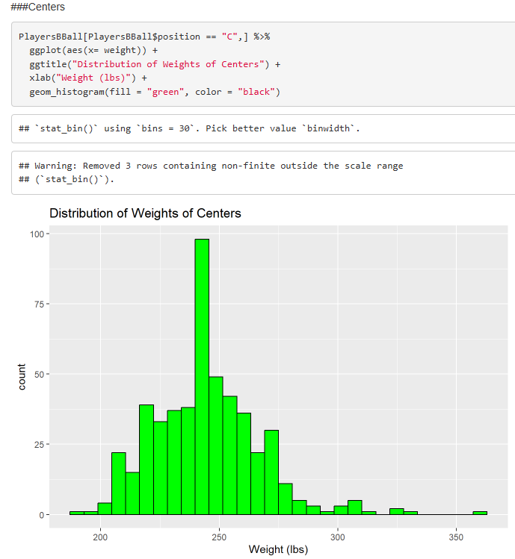
Notes:
Use the dataset to visually investigate the distribution of the weight of centers (C) is greater than the distribution of the weight of forwards (F).

Slide 4
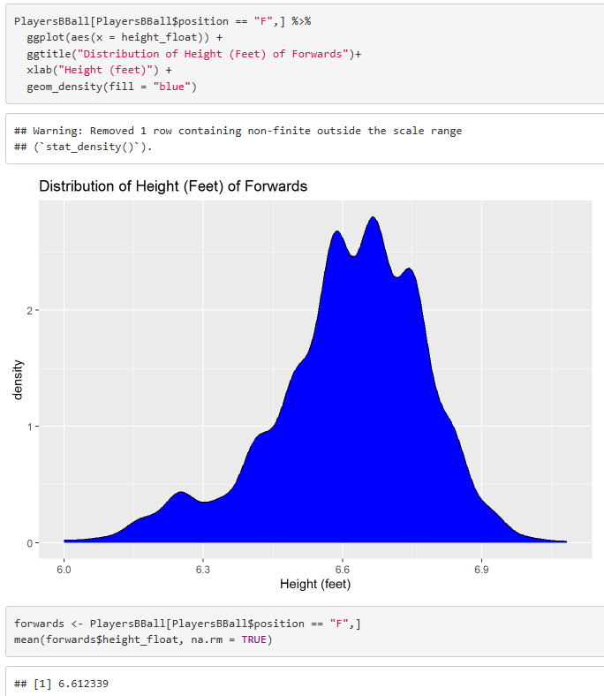
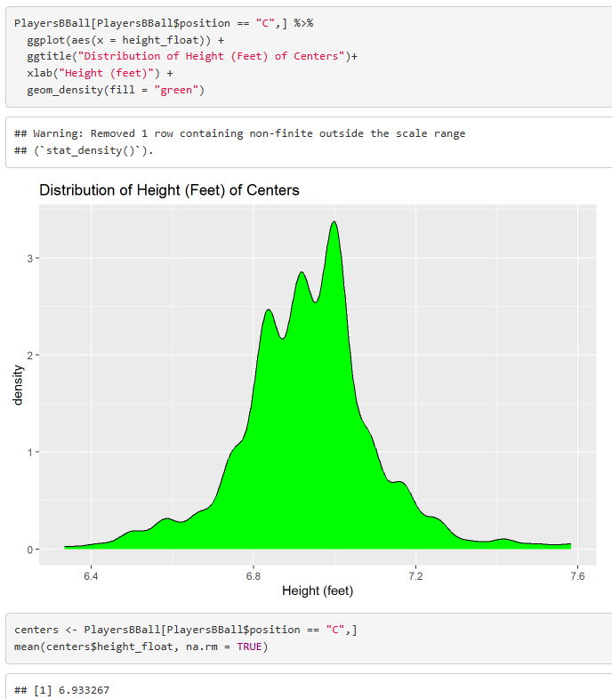
Notes:
Use the dataset to visually investigate if the distribution of the height of centers (C) is greater than the distribution of the height of forwards (F).

Slide 5
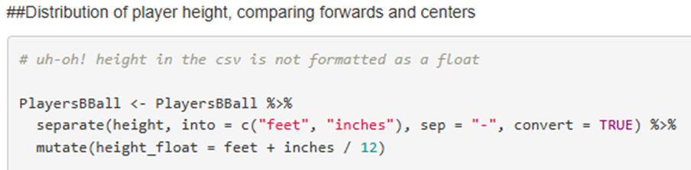

Slide 6
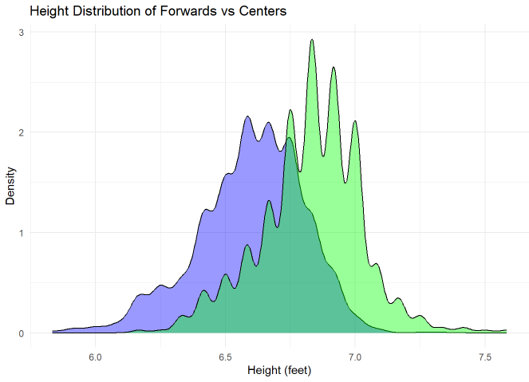
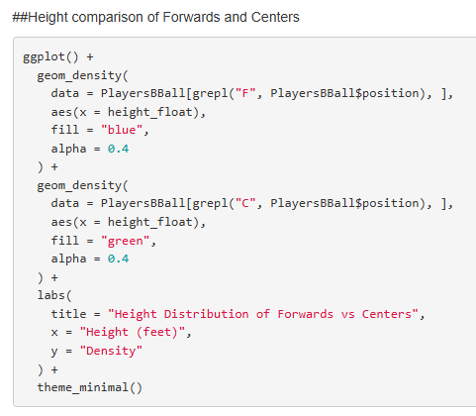

Slide 7
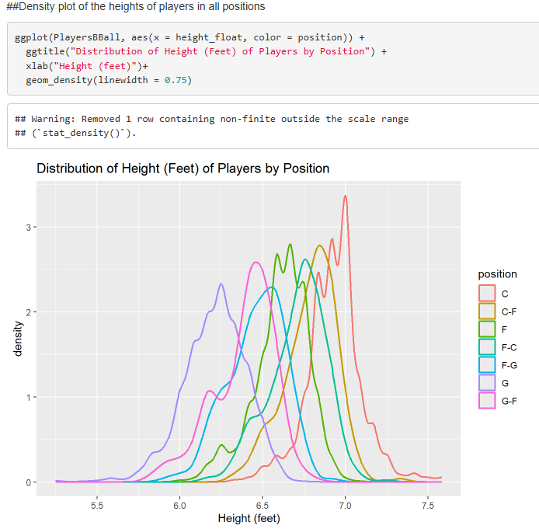
Notes:
Use the dataset to visually investigate if the distribution of height is different between any of the positions.

Slide 8
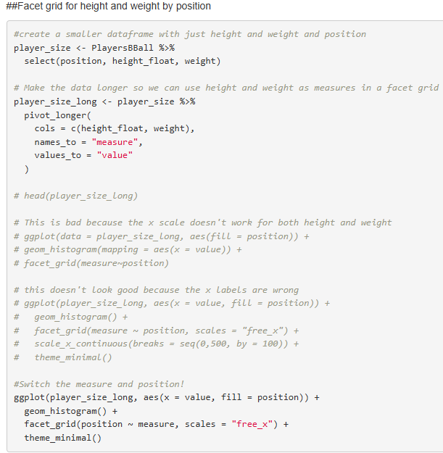
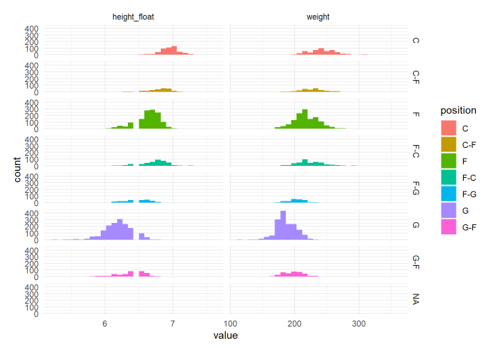

Slide 9
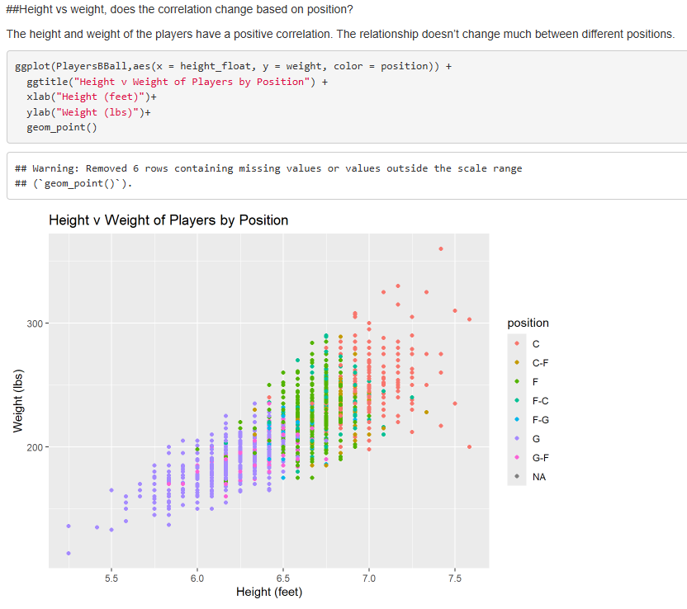
Notes:
Use the dataset to investigate how the player’s height is related to the player’s weight. How does height change as the weight changes?

Slide 10
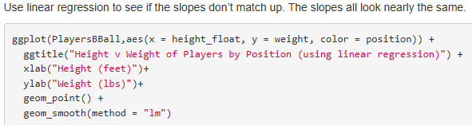
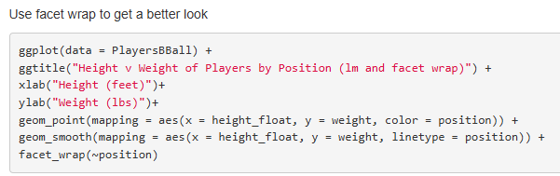
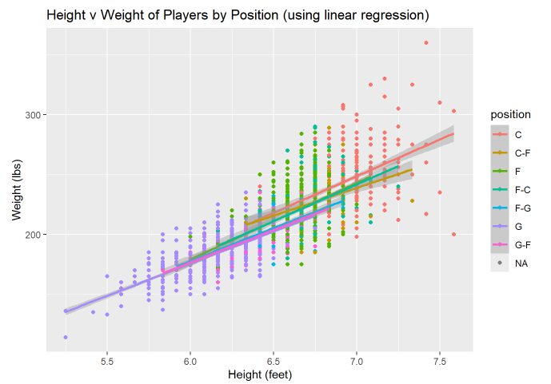
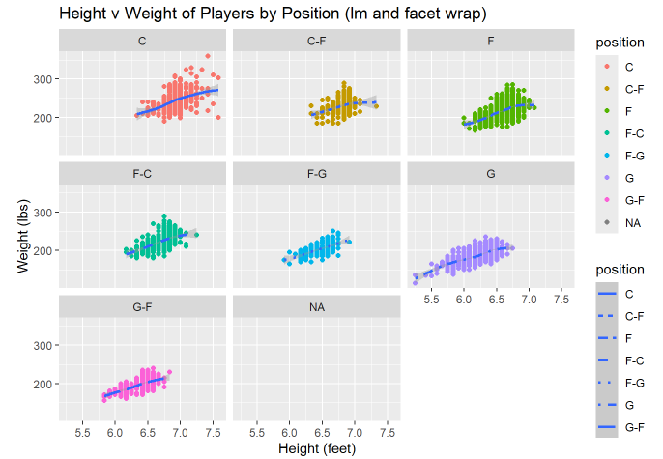
Based on these plots, the relationship between height and weight does not seem to vary between positions.
Notes:
Is their any difference in the relationship between height and weight between positions? Are height and weight related differently for different positions.

Slide 11
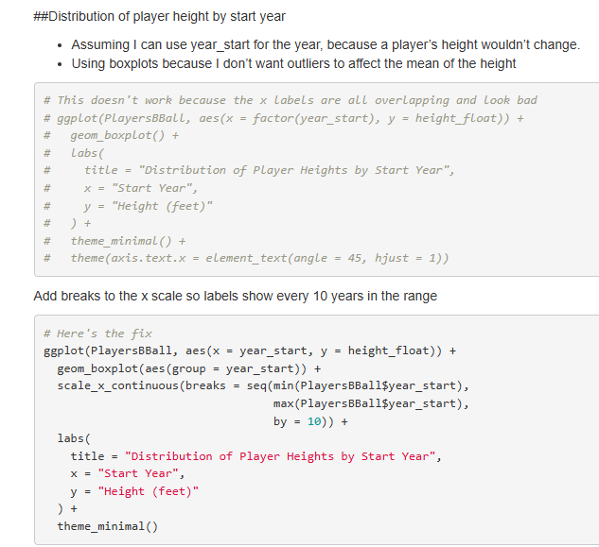
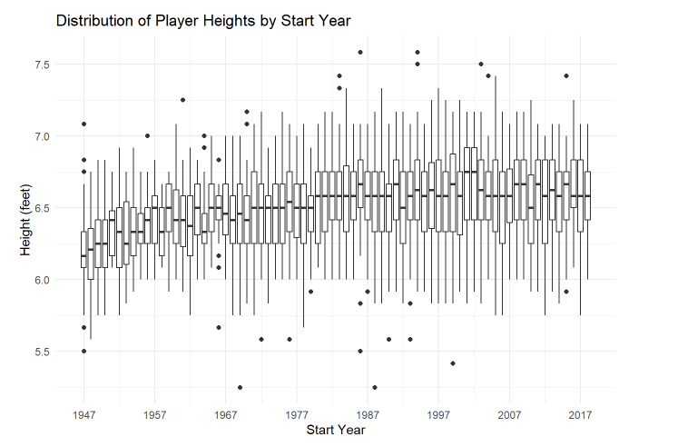
It looks like the height increase started to level out. What’s up with that?
Notes:
A historian would like to investigate the claim that the heights of players have increased over the years. Analyze this claim graphically / visually.

Slide 12
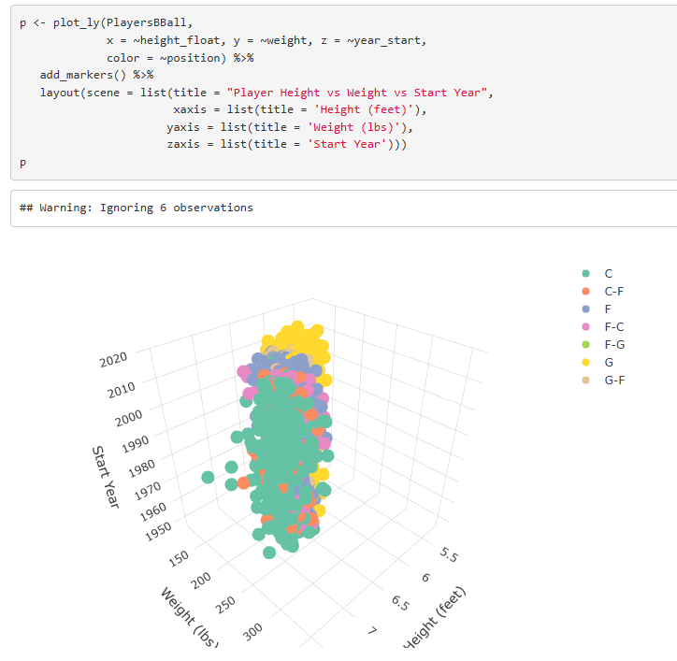
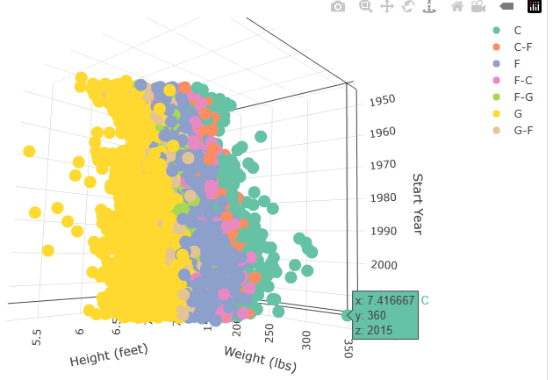
ggplotly(p) inspecting outliers
Notes:
Create a 3D plot of height vs. weight vs. year and color code the points by position.

Slide 13
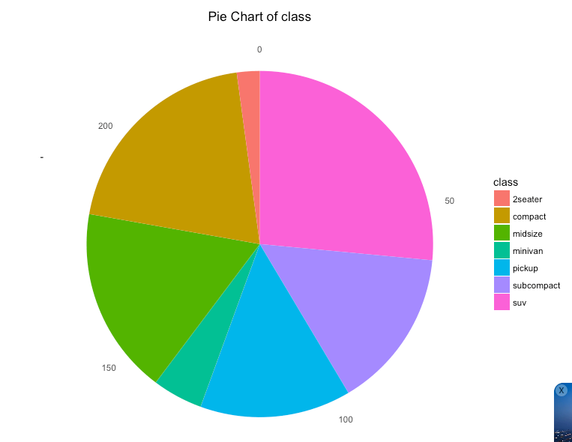
Classic visualization
Can be hard to read
Do not use with many categories
Color contrast should be immediately clear
The pie chart is classic, but some people find it hard to read because it requires you to distinguish between different hues, which can be difficult.
Therefore, it works better when the colors contrast more, but if there are many different categories it becomes harder to select sufficiently contrasting colors.
Notes:
Go to this website and use one of the 50 best plots to visualize some aspect of the data and provide at least one insight. You will present your work in breakout! http://r-statistics.co/Top50-Ggplot2-Visualizations-MasterList-R-Code.html

Slide 14
Takeaways and Questions
Inspect the data first. Look at the summary of the data and notice the min, max, mean. Think about the data types and whether they should be converted for better analysis.
What’s a good way to compare distributions? Other than simply noticing where they’re centered.
Layering density plots of height distribution was easier and looked better than trying to layer histograms of weight distribution.
Maybe putting labels on the lines in the density plot could be easier to read than trying to match the color to the legend. How to do that? Maybe add geom_text(), or just apply ggplotly.
Does the distribution of player heights by year look like it’s starting to level out in the late 1960s?

